Slide 1
Assignment 03 Helper slides

Slide 2
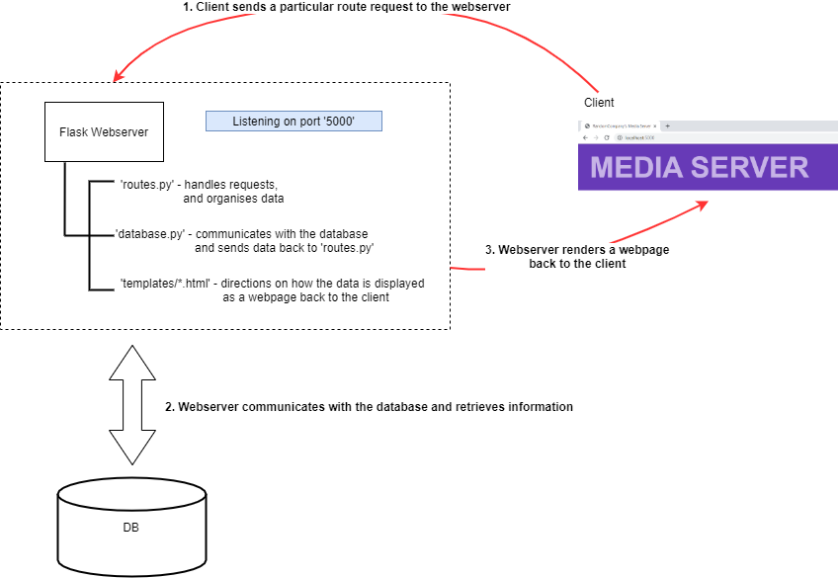
How does the system work?

Slide 3
What do you have to do?
Complete the database handling functions in ‘database.py’ (10 tasks)
Complete the route handing functions in ‘routes.py’ (4 tasks corresponding to 4 of the database handling tasks)
Complete the template displays in ‘templates/*.html’ (4 tasks corresponding to the route handing tasks)
If you complete just the 10 tasks for 1), you can get up to 5/10
If you complete all 18 tasks, you can get up to 8/10
To get the addition 2 marks, you must implement a new functionality, this will involve ALL of the following:
Create a new function in ‘database.py’
Create a new function in ‘routes.py’
Create a new template in ‘templates/*.html’
Add the appropriate menu items in ‘templates/top.html’

Slide 4
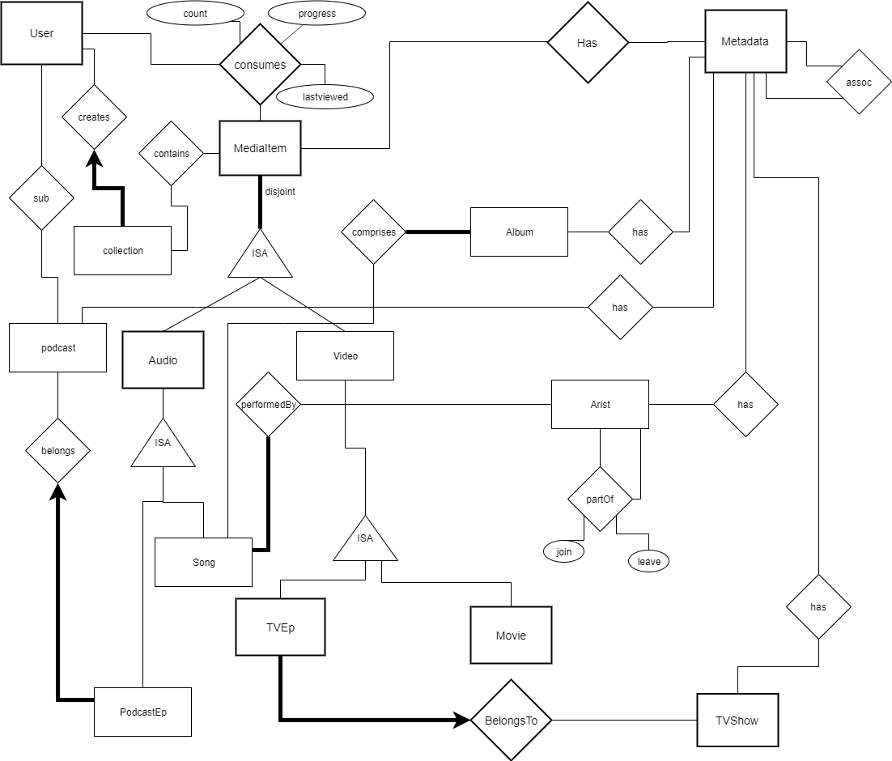

Slide 5
OMG That ERD looks whack
It looks very complicated, but most of that is due to the meta-data system.
Metadata is basically information about data. In this schema we use a series of metadata tables to store information about our various users, media items and how they are organised.

Slide 6
The Metadata system
Why design the system like this?
This metadata system lets us increase the dimensionality of the information we store regarding a media item without having to alter our schema. Instead, we introduce new types of entries into the metasystem and then use a (type,value) system similar to the one defined in A02 for the ‘features’ attribute for the ‘Component’ entity.
How will this affect my queries?
To get information about a media item, you will need to join it to it’s corresponding metadata table. Since different media items might have different (or no) metadata, this is likely means using a left outer join. You can find some examples in the assignment codebase.

Slide 7
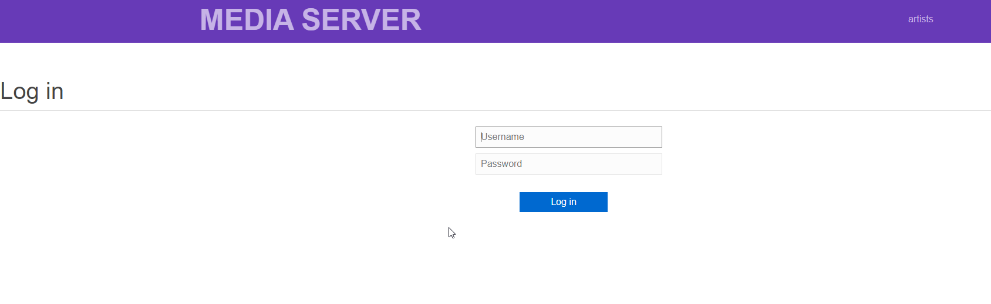
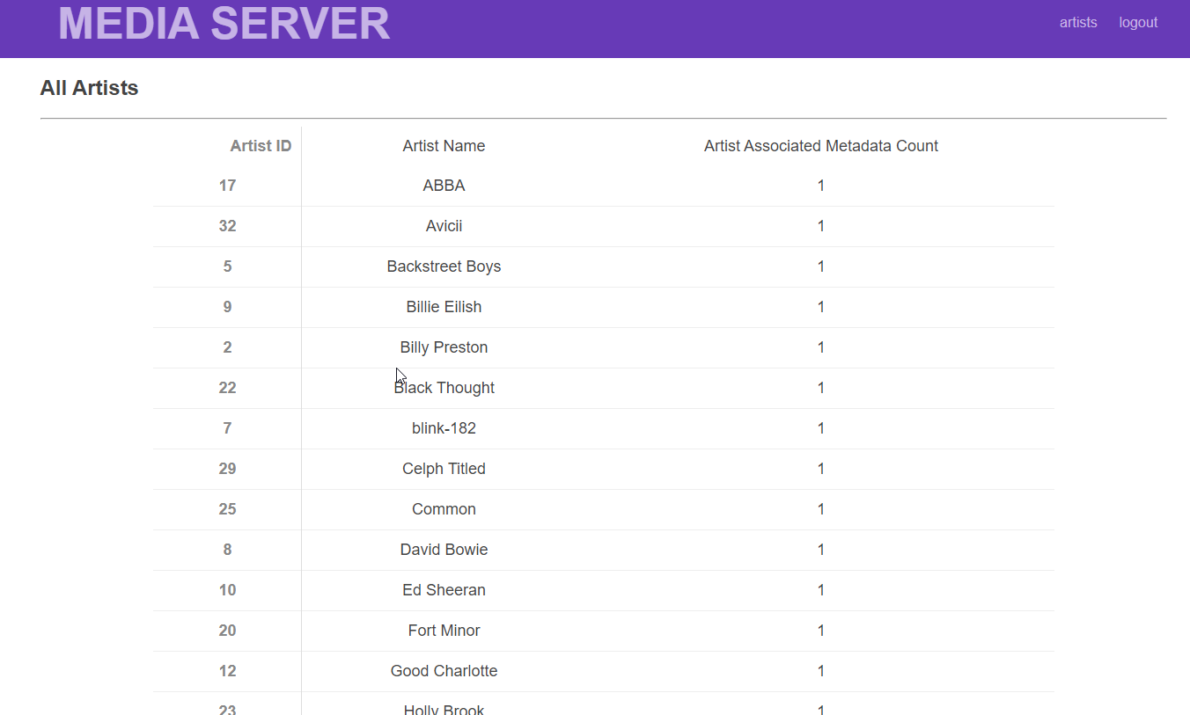
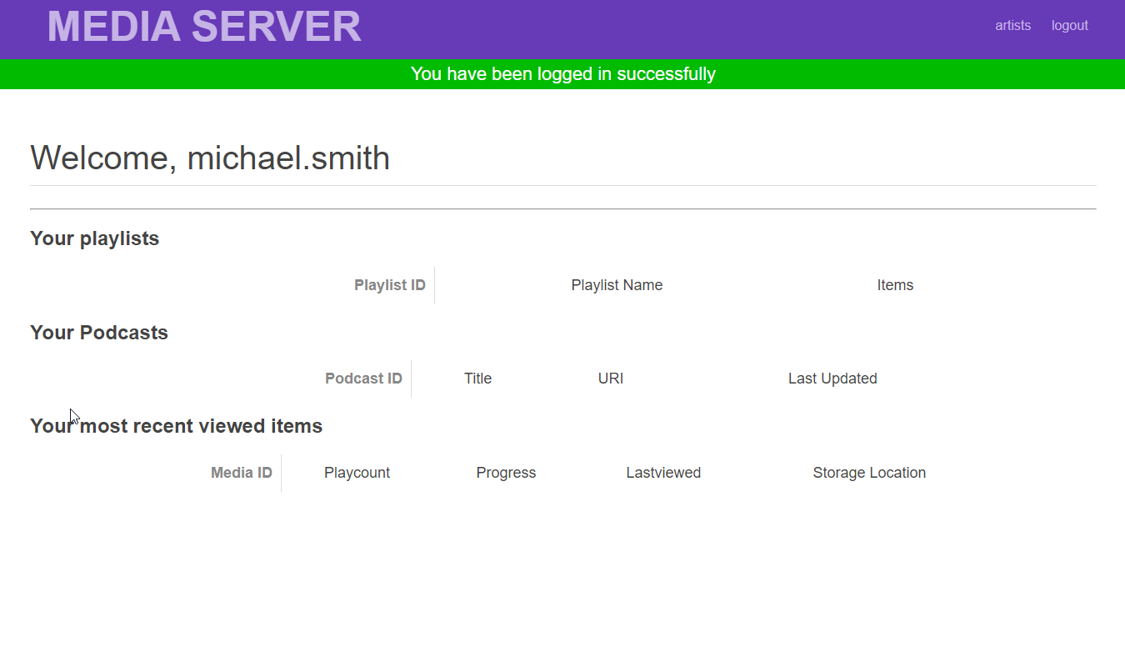
What it looks like

Slide 8
Specific Tasks – Database Tasks in ‘database.py’
Write SQL for getting/checking all relevant details needed to log a user into the system\be
Write SQL for getting all relevant details for a single song
Write SQL for getting Wall relevant details for all TV Shows along with their episode counts
Write SQL for getting all relevant details for a single TV Show and it’s episodes
Write SQL for getting all songs in an Album and their artists
Write SQL for getting all genres in an Album
Write SQL for getting all relevant details for a single podcast episode
Write SQL for getting all relevant details for a Podcast entity
Write SQL for ensuring a proper insert of a new Song
Write SQL for getting all relevant details for searching through all Movies

Slide 9
Specific Tasks – ‘routes.py’ Data handling
Handle data connections for a single podcast episode
Handle data connections for a Podcast entity
Handle data connections for adding a new Song
Handle data connections for searching through all Movies

Slide 10
Specific Tasks – ‘Templates/*.html’ Data Rendering
Handle display/rendering for a single podcast episode
Handle display/rendering for a Podcast entity
Handle display/rendering for adding a new Song
Handle display/rending for searching for a Movie

Slide 11
Recommendations for the extension portion
User Management (all of the options, not just one)
Updating password / adding a new user / new contact details
New Search Functionality
Find Related content (particularly using Genres)
Advanced:
Implementing Fuzzy search
Integrating a web-player to actually play content
Including keeping track of progress when player is halted or closed.

Slide 12
Where can I find more help?
Canvas Week 08 Tutorial
https://canvas.sydney.edu.au/courses/18176/modules
We have included the solutions – but fair warning, the solutions also used an example of code that was vulnerable to SQL injection. Make sure your code uses parameterised SQL.
Python
https://www.w3schools.com/python/
Flask
https://www.fullstackpython.com/flask.html
Templates: https://www.tutorialspoint.com/flask/flask_templates.htm
PG8000
https://www.programcreek.com/python/example/96338/pg8000.connect
HTML
https://www.w3schools.com/

Slide 13
How to set-up
Download the code base
Unzip into a directory
Update ‘config.ini’ with your unikey and SID
Use a postgres client to open and run ‘mediaserver-schema.sql’
Use a postgres client to open and run ‘mediaserver-sampledata.sql’
On Windows
Install Windows Subsystem for Linux (WSL)
Add a Ubuntu kernel
Open a bash terminal
Run ./run.command
On Mac / Linux
Run ./run.command
Open ‘127.0.0.1:5000’ on a browser to access the webserver client side

Slide 14
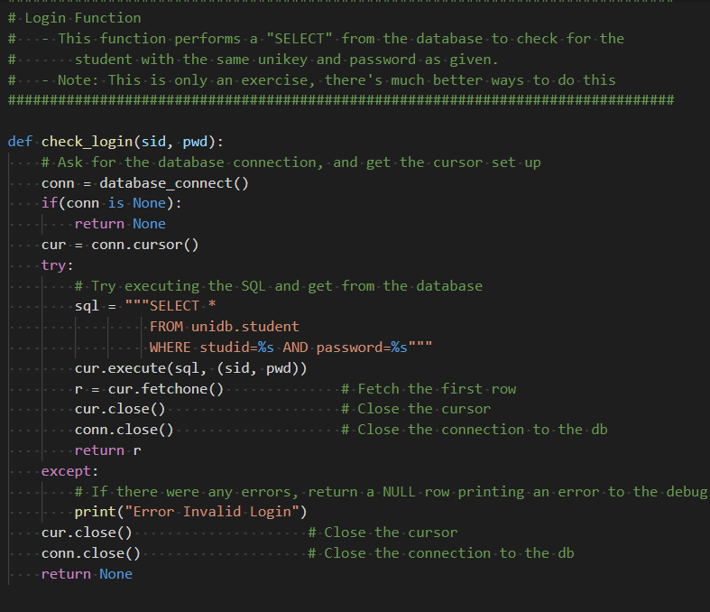
Thanks for the info but how do I even start?!
Task 1 begins with creating a login script
Let’s have a look at the week 08 tutorial.
That seems to be doing everything we need!

Slide 15
Starting …
We just need to change the table and schema names to be correct for the assignment.
So the SQL would be:
```
Select *
FROM mediaserver.UserAccount
Where username=‘%s’
AND
password=‘%s’;```

Slide 16
… And that’s Task 1a Finished!
You can now log in.
Have a look at some sample data to find some user names.

Slide 17
Files to Load
First Load ‘mediaserver_schema.sql’
After running that, load ‘mediaserver_sampledata.sql’

